Slide 1
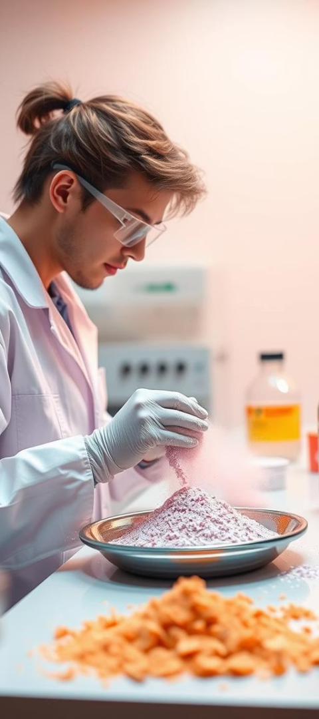
Application of MK-N220 nanoparticles as a Hemo-static agent.
Under the supervision of
Dr. SHANTANU KUMAR BEHERA
By: SAIRAJ RAMAN KUMAR CHOWDHARY D
721CR2025
Courtesy: Laboratory of New Ceramics(LaNCer)NIT RKL &
Biomimetics lab(BM-BT Dept.) NIT RKL

Slide 2
Objectives of the study
To synthesis MK-NC composite powder through PDC route.
Structural, micro-structural characterisation of the as-prepared MKC composite powder.
Microstructural objective is to produce nanoparticles of MK-C(N220) for Bio-molecule application
To obtain better clotting time of blood with better coagulation.

Slide 3
Literature Review
Polymer-derived ceramics(PDC's) find applications as oxidation resistant high temperature ceramic materials in the form of fibre, coatings and adhesives, and matrix of ceramic matrix composites for end-use in biomedical devices, drug delivery systems etc.,
Polymer derived ceramics(PDC) prepared by the pyrolysis of organic polymer precursors are unique materials with excellent high temperature stability, and novel electrical, optical, and chemical properties. However, PDC materials during high temperature pyrolysis (typically 1000°C or higher) coarsen and attain very low specific surface area (SSA) due to collapse of the pore structure.
A higher specific surface area is usually more beneficial for promoting blood clotting because it provides more surface area for interaction with blood components like platelets and coagulation factors, allowing for faster activation and aggregation at the wound site.
Poly-Methyl-silsesquioxanes have been numerously used to produce SiO2 or SixOyCz ceramics through pyrolysis under different atmospheres. According to the manufacturer, approximately 82 wt% SiO2 content after pyrolysis at 1000 °C in air was expected.

Slide 4
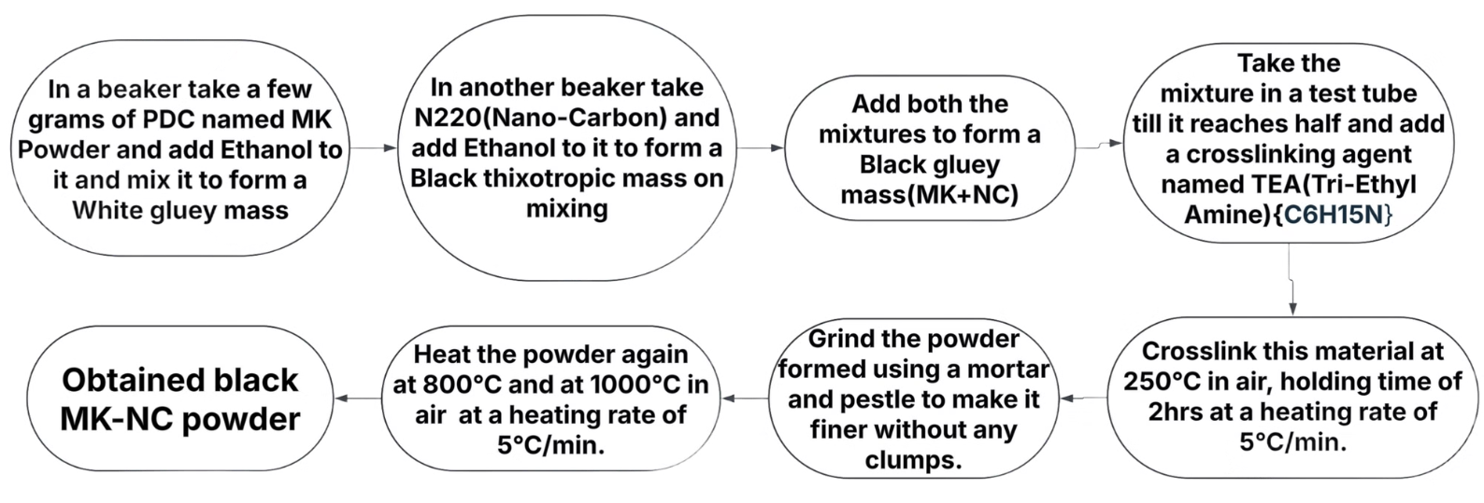
Synthesis

Slide 5
Nomenclature of Samples
Sample Name
Preparation Route
Heat Treatment Temperature
NMK8
MK PDC + Nano-Carbon (N220) mixed and cross-linked at 250°C
800°C
NMK10
MK PDC + Nano-Carbon mixed and cross-linked at 250°C
1000°C
NMK11
MK PDC + Nano-Carbon mixed and cross-linked at 250°C
1100°C
NMK12
MK PDC + Nano-Carbon mixed and cross-linked at 250°C
1200°C
MK - Poly-Methyl-silsesquioxane

Slide 6
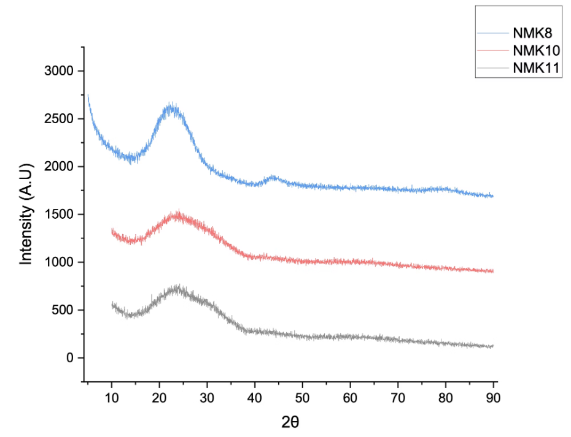
XRD Analysis
Here the graphs represent the XRD analysis of Cross-linked, Heated samples in the same order. From the XRD plots, we know the different phases obtained in the in-situ synthesis for both 800°C, 1000°C and 1100°C temperatures. The graph shows a reflection of carbon peak at ~24.6°,~24.8° in the plane.

Slide 7
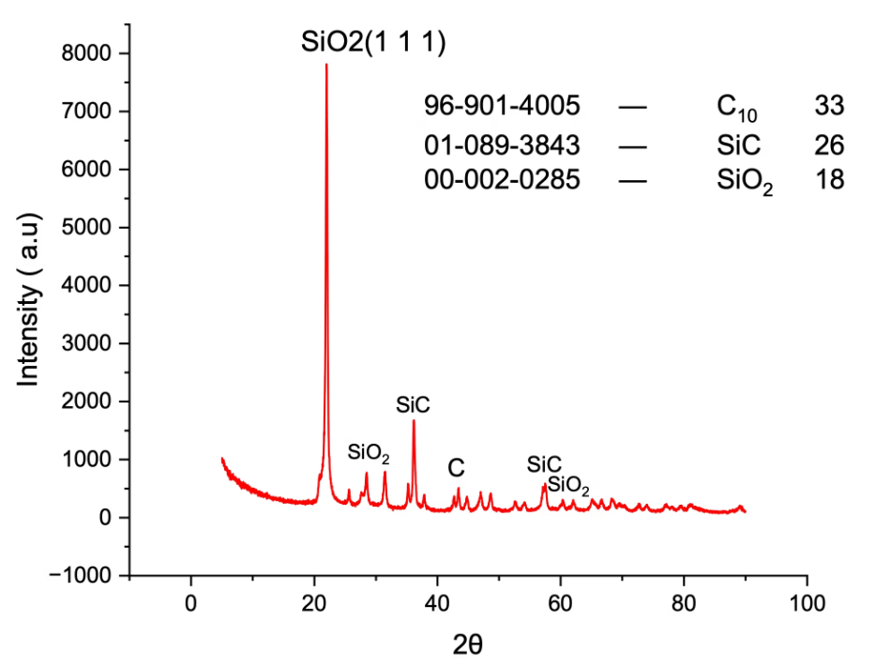
XRD Analysis
Sample: NMK12
The graph shows a reflection of SiO2 peak at ~ 21.990° in the (101) plane called Cristobalite formed at 1150°C and at 31.5° in (102) and 36° in (200) plane.And SiC peak at 36.126°. (hkl) define the reciprocal axial intercepts of a plane of atoms with the unit cell –The (hkl) plane of atoms intercepts the unit cell at a/h, 𝑏/𝑘, and 𝑐/𝑙.

Slide 8
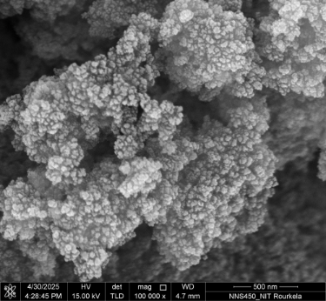
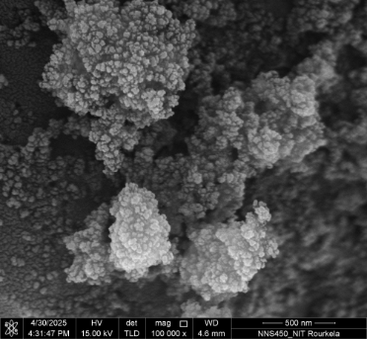
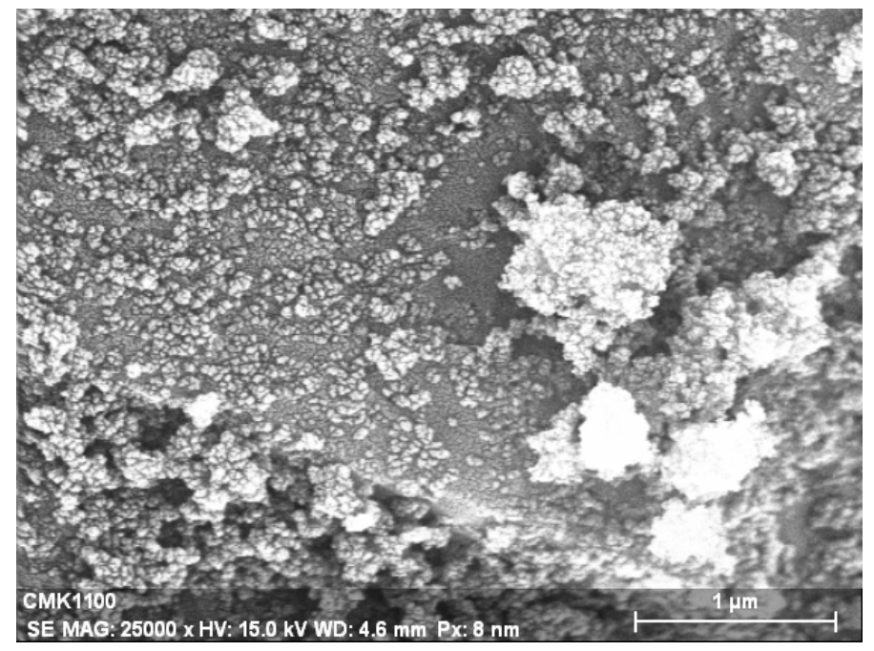
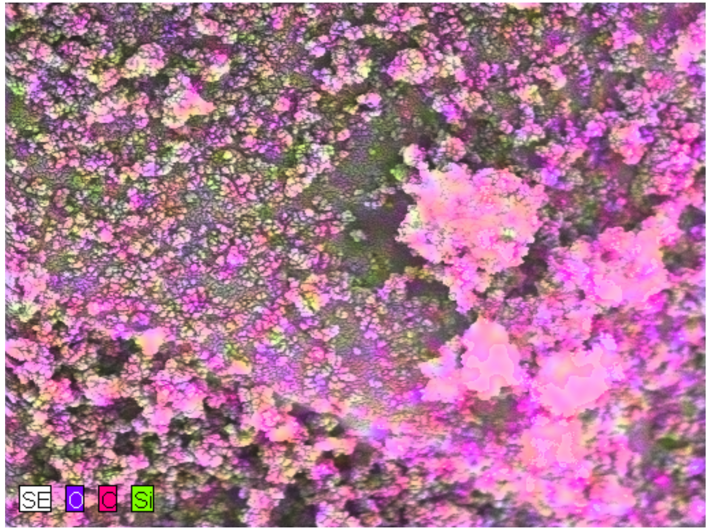
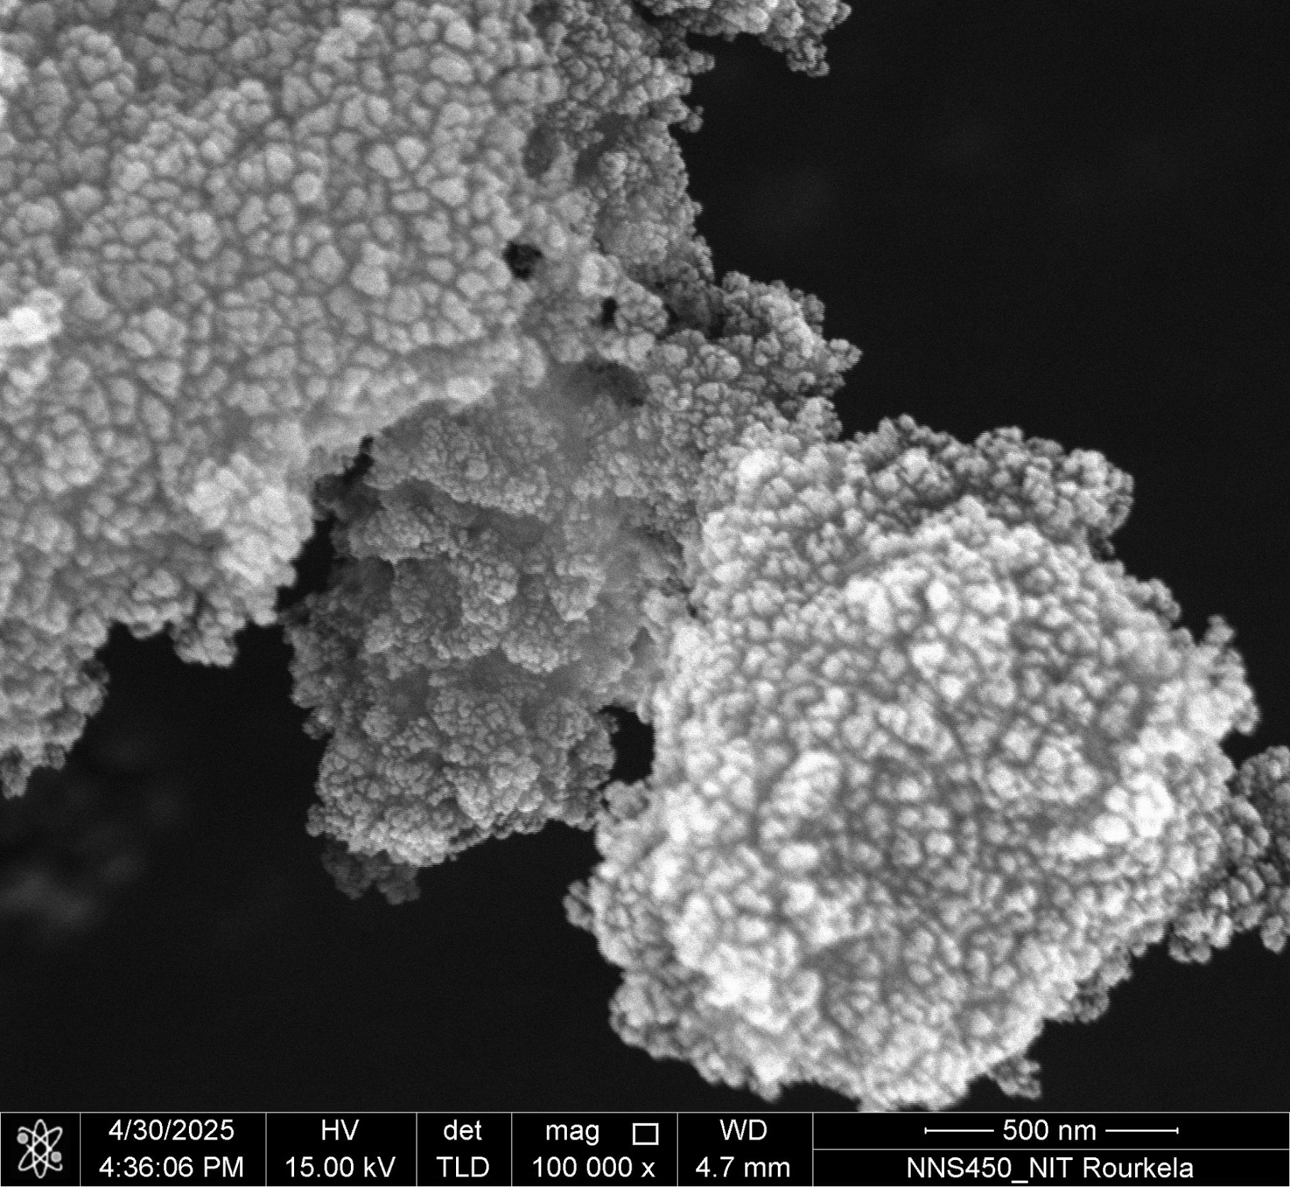
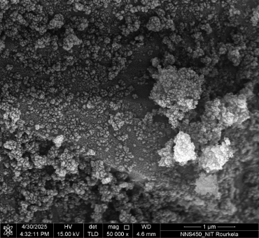
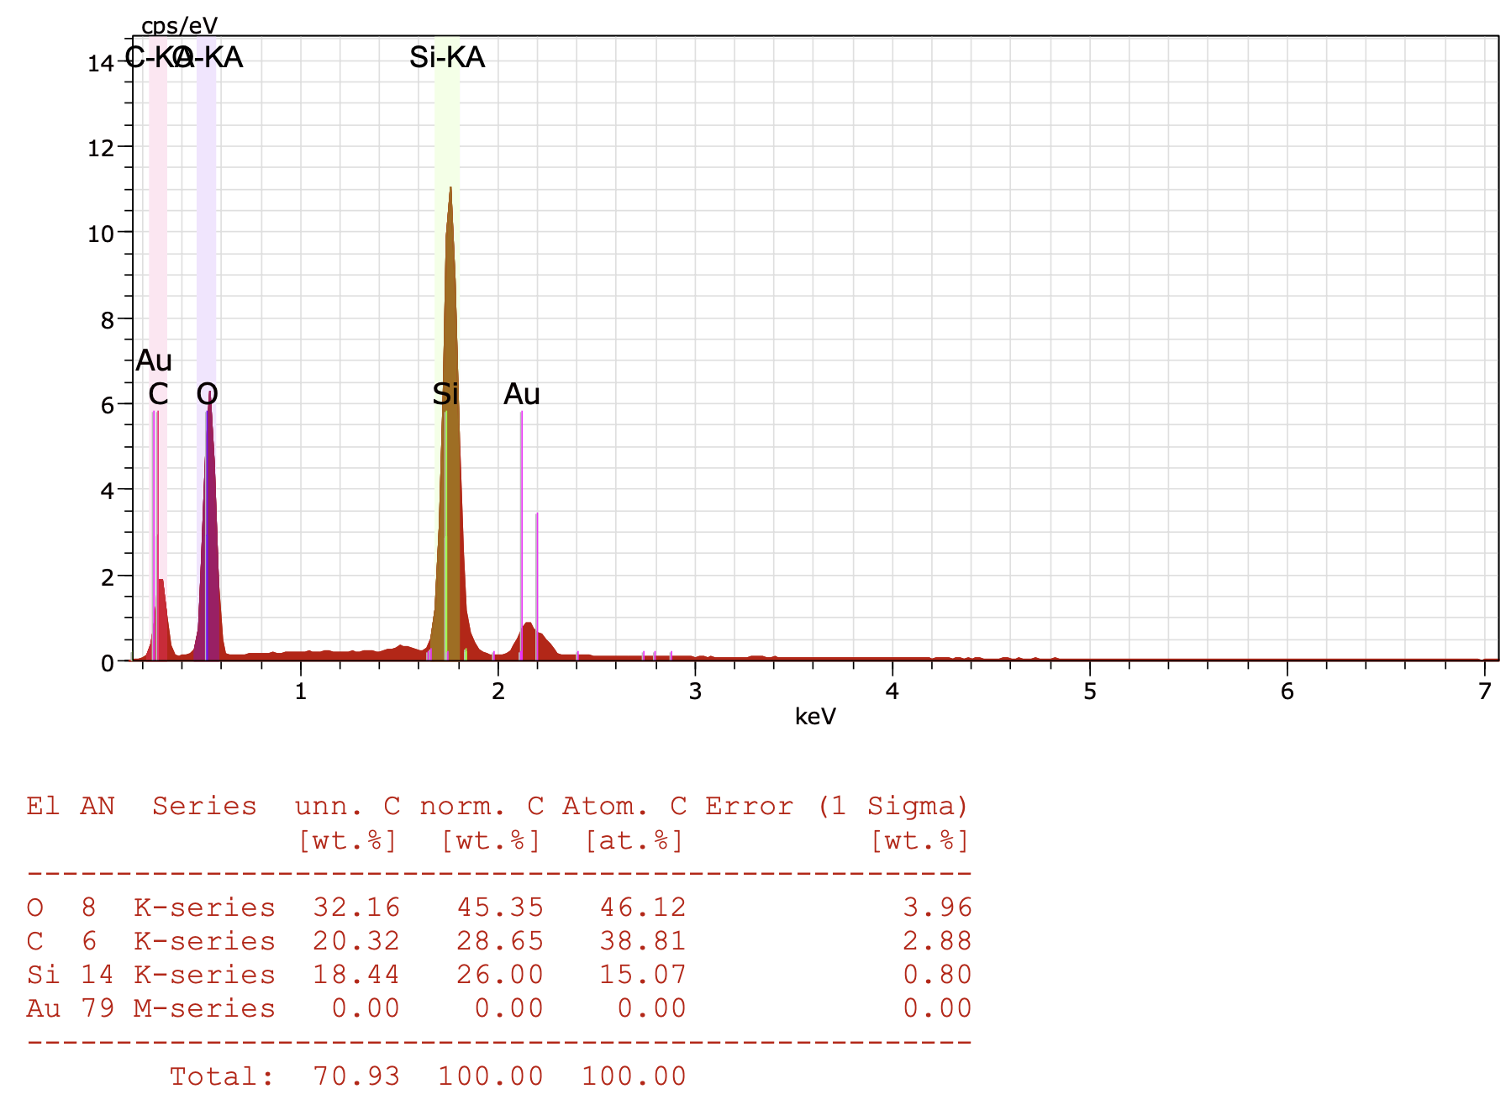
Microstructure Analysis
a)
b)
Sample: NMK11(FESEM)
500nm
500nm
c)
d)
500nm
500nm

Slide 9
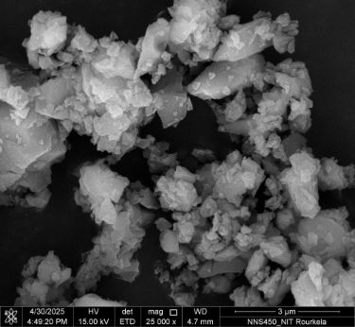
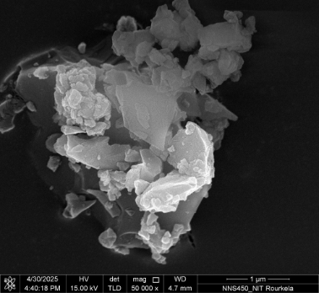
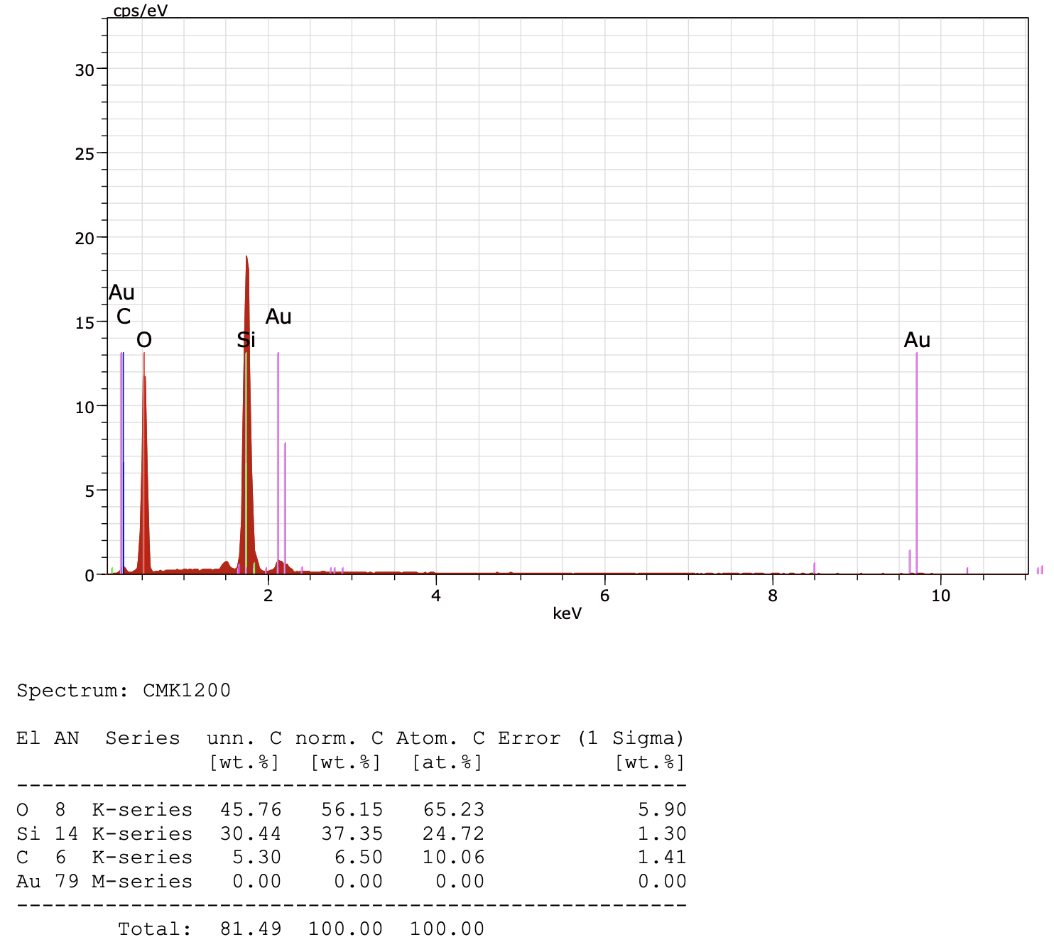
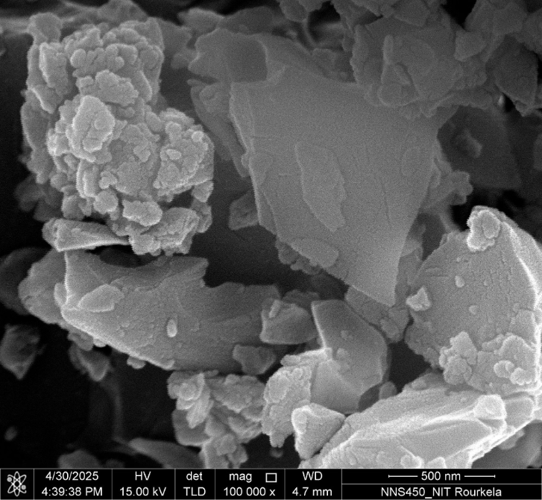
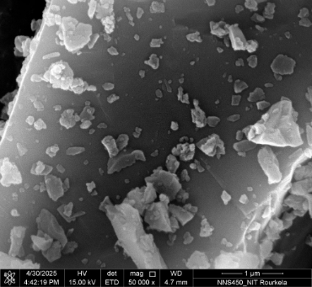
Microstructure Analysis
a)
b)
Sample: NMK12
3um
1um
c)
d)
500nm
1um

Slide 10
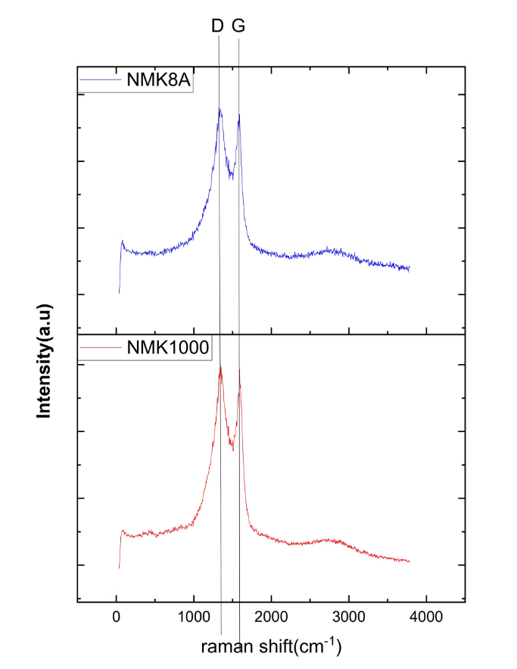
Raman Spectroscopy
Raman Spectra and Nano-Carbon Phases: D and G bands observed between 1354.5 and 1587.5cm⁻¹. D-Disordered Carbon and G-Graphitic Carbon.

Slide 11
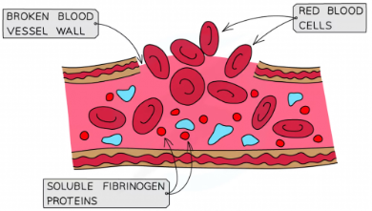
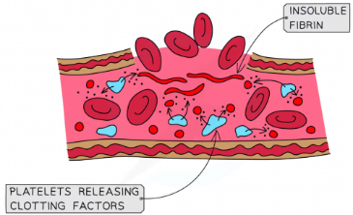
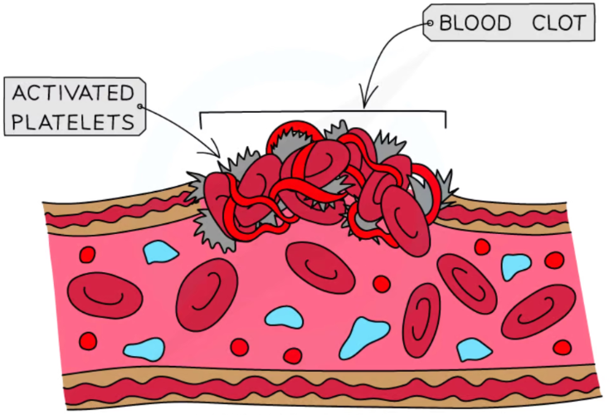
Mechanism of a Blood Clot
Vasoconstriction (the narrowing of blood vessels by small muscles in their walls)
Platelet adhesion and activation (Plug formation)
The coagulation cascade(Activation of Clotting Factors, Fibrin Formation and Secondary Hemostasis)
Clot retraction (Platelet Contraction, Wound Healing)
Procedure: Performed by adding 20µL of calcium chloride solution to 200µL of the blood samples added in the micro-centrifuge tube to begin the coagulation cascade via plasma recalcification. Followed by which the samples named as NMK10, NMK11, NMK12 and NMK8 were dropped instantly in the recalcified blood and stopwatch has started recording the time the sample takes to clot the blood. The whole procedure was repeated at least thrice for all the concentration samples. The invert tube method was performed for estimation of clotting time of the nanoparticles and the clotting time was noted down. After the clotting time was recorded when blood have stopped flowing, the clot was scooped out with the help of spatula for better confirmation.

Slide 12
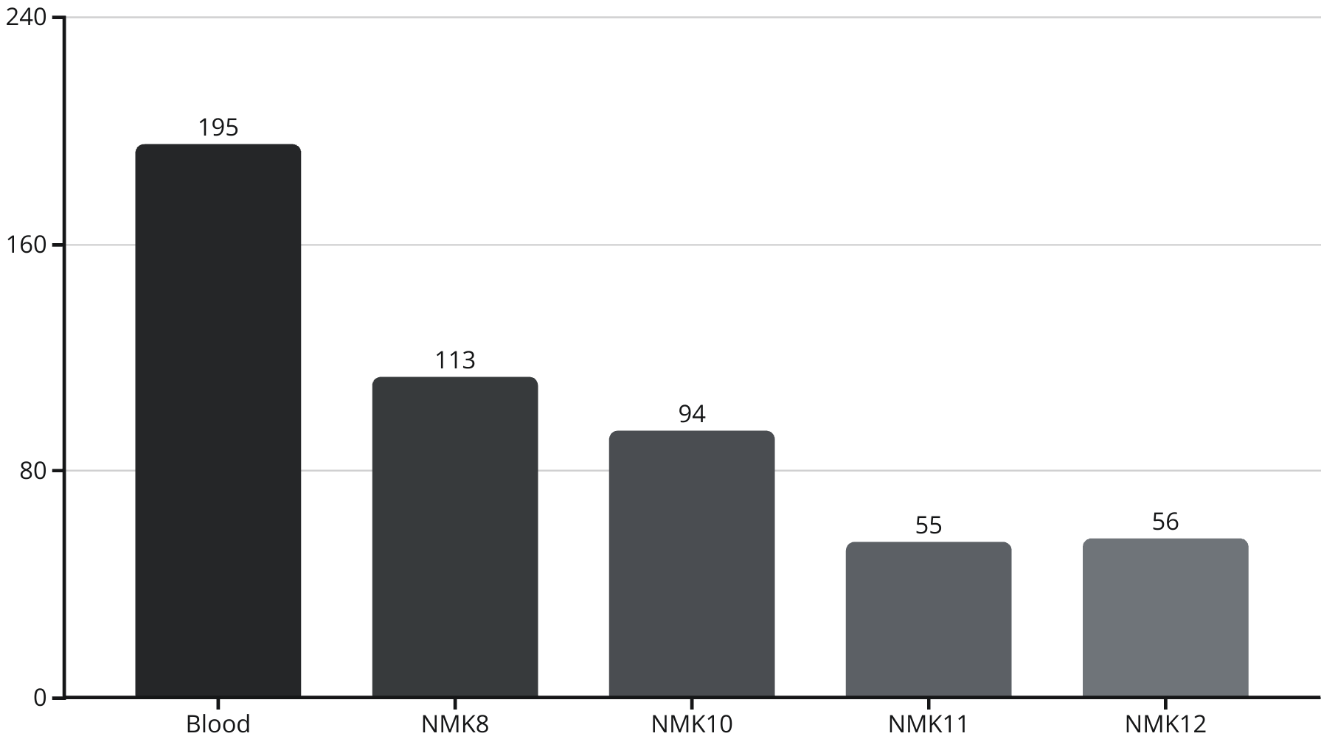
Blood Clotting Time
Clotting Time( in Seconds)
Adding 20µL of Calcium Chloride solution to 200µL of the blood samples added in the Eppendorf tube to begin the coagulation cascade via plasma re-calcification. Followed by which the samples named as NMKA, NMK11, NMK12 and NMK8 were dropped instantly in the re-calcified blood and stopwatch has started recording the time that sample takes to clot the blood.

Slide 13
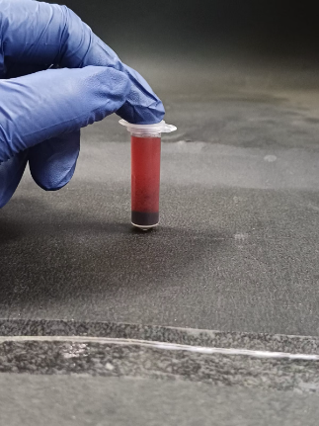
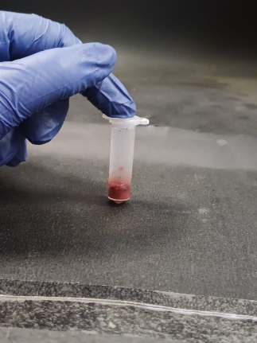
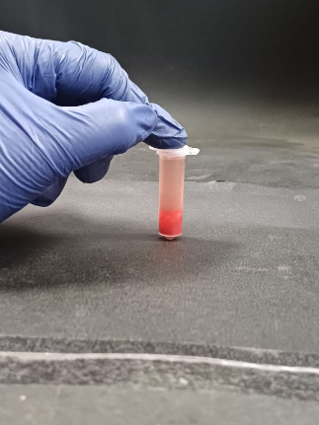
Blood Clot
Started with 20mg of NMKA which gave a clotting time of 94 seconds and 20mg of NMK8 got 113 seconds.
When we took 10mg PEC+10mg NMKA +50uL PEG, clotting started at 71 seconds but strong clot formed at 133 seconds.
10mgPEC+10mg NMK8+50uL PEG took 104 seconds for clotting to begin and 217 seconds to form strong clot.
10mg PEC + 10mg NMK11 formed a clot in 55 seconds and 10mg PEC+ 10mg NMK12 formed a clot in 56 seconds.
And 10mg PEC + 10mg NMK11 + 50uL PEG initiated a clot in 32 seconds and completely clotted in 59 seconds. But NMK12 did not clot properly with more Prothrombin Time.
As soon as the coagulation started the nanoparticles became a lump like structure and there was formation of strong clot by the samples.

Slide 14

Future Directions
Perform BET surface area analysis.
To perform Ex-vivo
To perform prothrombin time (PT) test using Platelet-poor plasma(PPP) that undergoes centrifugation at 3000g and PEC-treated PPP will be incubated in Automated blood coagulation analyser.

